Slide 1
IST - Overview

Slide 2
Quick Overview of Credit card systems
Who is Acquirer?
Who is Issuer?
Who is merchant?
Who is Card Association?
Who is Card holder?
Do you have Credit card?..

Slide 3
Quick Overview of Credit card systems
IST products
IST
Switch
Clearing
Merchant Accounting System

Slide 4
What is IST/Switch
IST/Switch is a high performance payments transaction switch for all transaction processing needs. Whether driven by real-world, virtual, or wireless payment channels, IST/Switch can communicate with an unlimited number of devices and can route transactions to a limitless number of networks and host systems. IST/Switch is deployed to 138 software customers across the globe

Slide 5
What is IST/Clearing
FIS IST/Clearing is designed to prepare transactions for clearing to the card associations and to receive transactions from the association.
FIS IST/Clearing is designed to be fully compatible with Association regulations (compliance), and supports multi-currency transactions for all plans supported by Visa, MasterCard, American Express, JCB, Union Pay, Discover and Diners.
From an acquiring perspective, the FIS IST/Clearing product takes retailer deposit and acquirer exception management system transaction files

Slide 6
What is IST/MAS
The Merchant Accounting System (FIS IST/MAS) is a multi-card, multi-currency system designed to enable merchant settlement and fee assessment.

Slide 7
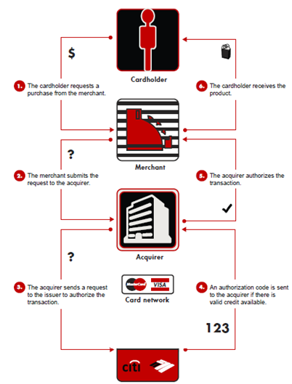
Credit card Authorization flow

Slide 8
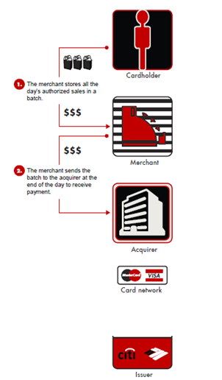
EOD processing

Slide 9
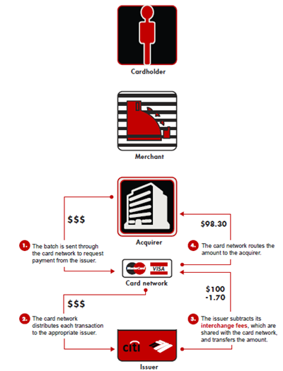
Clearing processing

Slide 10
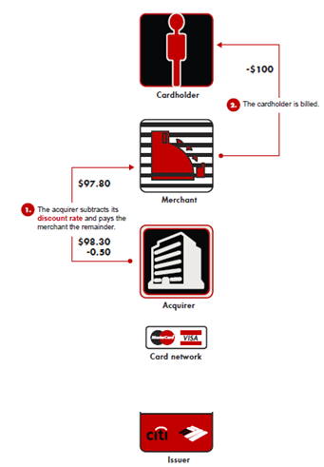
Settlement processing

Slide 11
Integrated IST
Card Association
& Domestic Issuer
Auth Interfaces
Voice Auth
Switch
Authorization Request/Response
Batch Auth
Transactions/Status Messages
ATM Auth
FraudManager
POS / Web
Host Capture
Card Association
& Domestic Issuer
Clearing Interfaces
Interchange Transactions
Service/Setup
GUI Screens
Manual
Capture
IST/Global Clearing
Enterprise View
GUI
DataNavigator
Entitlement
Common
Database
Merchant
Deposits
Payments
GL Interface
Exception Items
Merchant
Bank
IST/MAS
GL System
Invoices
Remittances
Chargebacks

Slide 12
?? Questions ??

